Slide 1
MEASURES OF RELATIONS

Slide 2
Is the measures of relationships between two variables X and Y.
It gets the linear relationships within the plots.
Correlation is a measure of association between two variables.
The two most popular correlation coefficients are: Spearman's correlation coefficient and Pearson's product-moment correlation coefficient.

Slide 3
Correlation Coefficient And Coefficient of Determination
The quantity r, called the linear correlation coefficient, measures the strength and the direction of a linear relationship between two variables.
The coefficient of determination, r 2, it gives the proportion of the variance (fluctuation) of one variable that is predictable from the other variable. It is a measure that allows us to determine how certain one can be in making predictions from a certain model/graph.

Slide 4
Pearson's product moment correlation coefficient
used when the data are in interval scale
The Pearson correlation coefficient is a number between -1 and +1 that measures both the strength and direction of the linear relationship between two variables.
∑ dxdy
r
=
p
(sdx)(sdy)(n-1)
where:
dx = x-x sdx = standard deviation of x
dy = y-y sdy = standard deviation of y

Slide 5
Spearman's rank correlation coefficient
6 ∑ Di²
r
=
1 -
s
n(n²-1)
Where:
Di = Rx_{i} − Ry_{i} = the difference between the ranks of corresponding values X_{i} and Y_{i}
n = the number of values in each data
used when the data are in ordinal scale

Slide 6


IQ, X_{i} | Hours of TV per week, Y_{i} | rank x_{i} | rank y_{i} | d_{i}
86 | 0 | 1 | 1 | 0 | 0
97 | 20 | 2 | 6 | −4 | 16
99 | 28 | 3 | 8 | −5 | 25
100 | 27 | 4 | 7 | −3 | 9
101 | 50 | 5 | 10 | −5 | 25
103 | 29 | 6 | 9 | −3 | 9
106 | 7 | 7 | 3 | 4 | 16
110 | 17 | 8 | 5 | 3 | 9
112 | 6 | 9 | 2 | 7 | 49
113 | 12 | 10 | 4 | 6 | 36

Slide 7
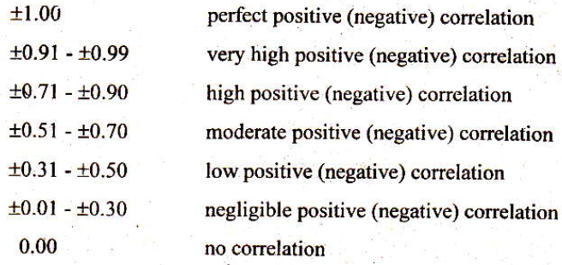
Guide in interpreting the
coefficient of correlation

Slide 8
The value of r is such that -1 < r < +1.
The sign (+/-) of the correlation coefficient indicates the direction of the correlation. A positive (+) correlation coefficient means that as values on one variable increase, values on the other variable tend to also increase; a negative (-) correlation coefficient means that as values on one variable increase, values on the other tend to decrease, that is, they tend to go in opposite directions.

Slide 9
Positive correlation: An r value of exactly +1 indicates a perfect positive fit. Positive values indicate a relationship between x and y variables such that as values for x increases, values for y also increase.
Negative correlation: An r value of exactly -1 indicates a perfect negative fit. Negative values indicate a relationship between x and y such that as values for x increase, values for y decrease.
No correlation: If there is no linear correlation or a weak linear correlation, r is close to 0. A value near zero means that there is a random, nonlinear relationship between the two variables.
A perfect correlation of ± 1 occurs only when the data points all lie exactly on a straight line. If r = +1, the slope of this line is positive. If r = -1, the slope of this line is negative.
A correlation greater than 0.8 is generally described as strong, whereas a correlation less than 0.5 is generally described as weak.

Slide 10

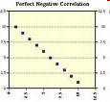
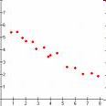
Perfect Positive Correlation
Perfect Negative Correlation
Strong Negative Correlation
Notes:
10

Slide 11
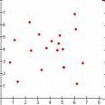
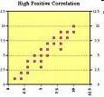
No Correlation
Strong Positive Correlation
Notes:
11

Slide 12
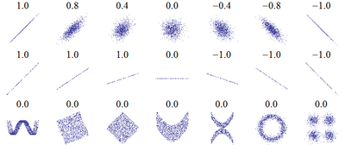
Sample..

Slide 13
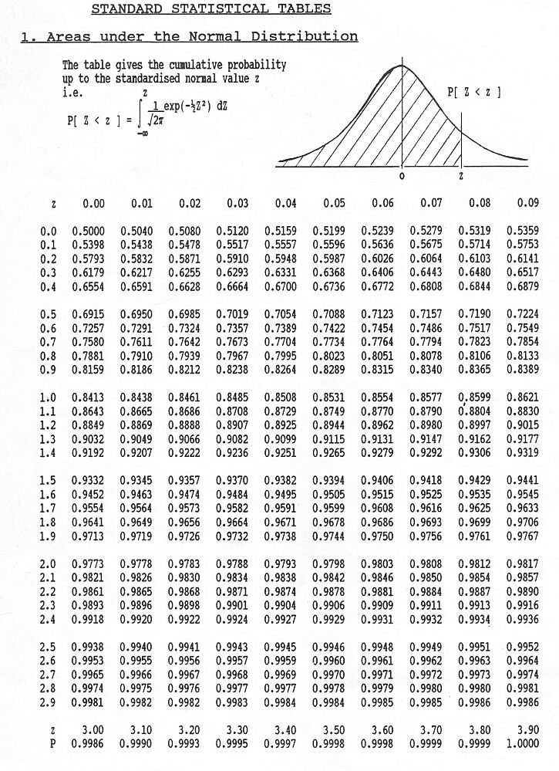

Slide 14
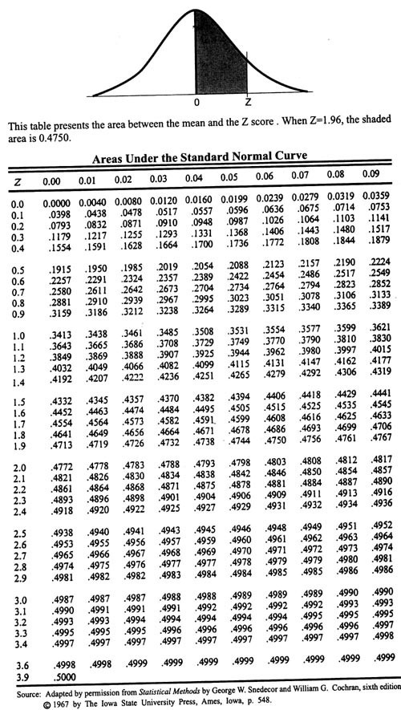

Slide 15
Example 1. Beauty & Sociability. Person Beauty Sociability
A 3 3
B 1=most 2
C 2 1=most
D 5 4
E 4
5N=5

Slide 16
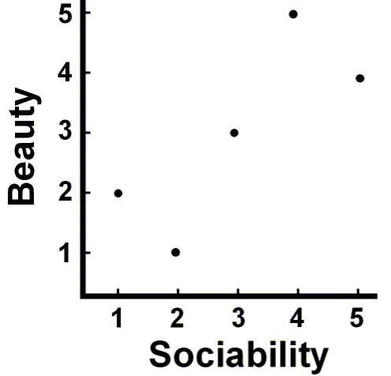

Slide 17
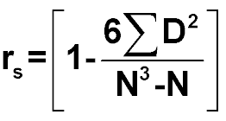
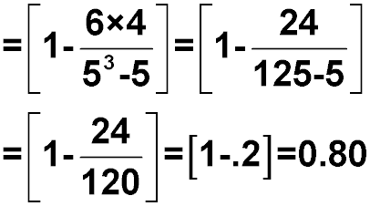
Person | Beauty | Sociability | D | D²
A | 3 | 3 | 0 | 0
B | 1=most | 2 | -1 | 1
C | 2 | 1=most | 1 | 1
D | 5 | 4 | 1 | 1
E | 4 | 5 | -1 | 1
N=5 |  |  | åD=0 | åD²=4

